Slide 1
Market access and farmers revenue in Nigeria
Capstone project presented by Saint Roger

Slide 2
Outline
Background
Analysis
Methods
Results
Findings
Conclusion

Slide 3
Motivation
Story of farmers in Sub-Saharan Africa
Impact of farmers struggle
Farming Background
Solution/entrepreneurship

Slide 4
Question
Does market access have an impact on farmer total revenue from sales?

Slide 5
Data Analysis
Living Standard Measurement Survey
4 waves (2010, 2012, 2015, 2018)
Data Cleaning
1412 Observations

Slide 6
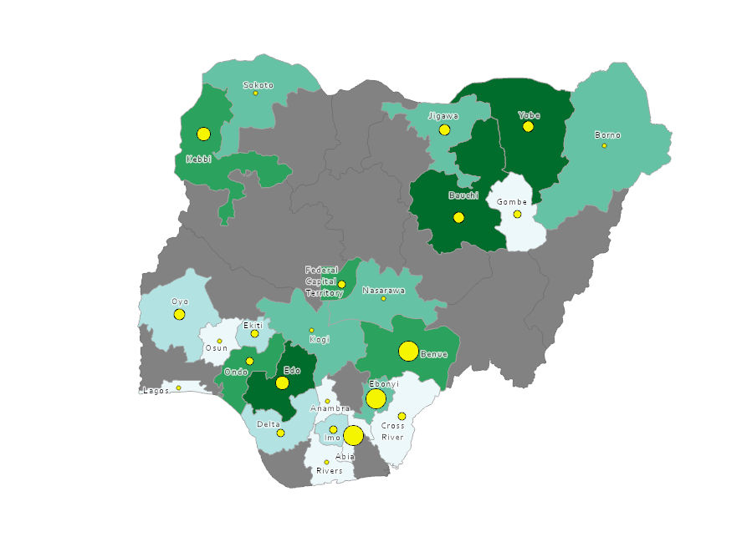

Slide 7
Economics methods
Fixed effect

Slide 8
Results

Slide 9
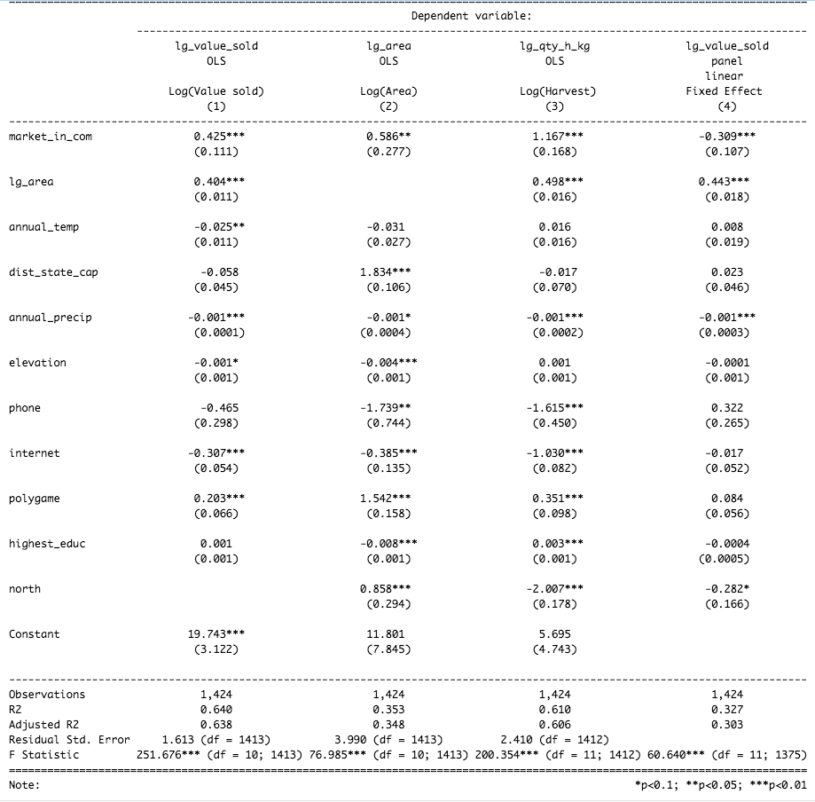

Slide 10
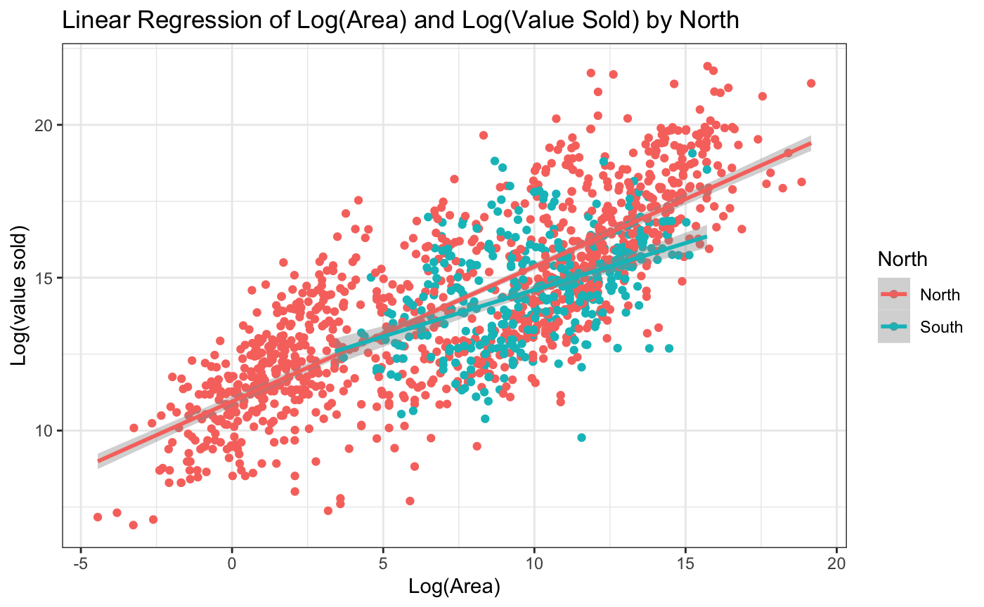
Findings

Slide 11
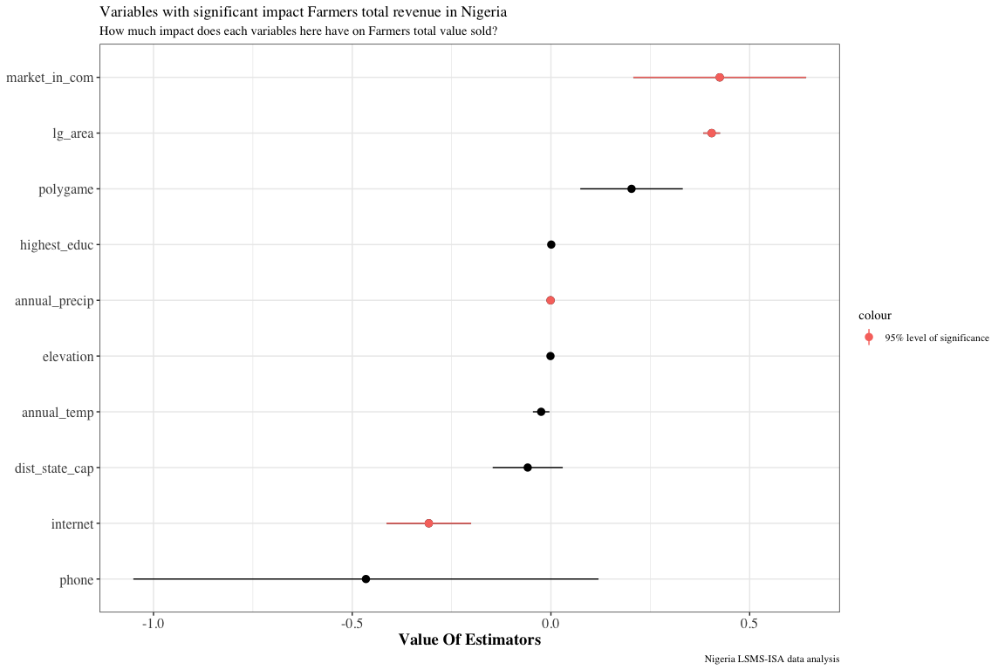

Slide 12
Challenges and limitations

Slide 13
Conclusion
There is significant evidence that market in a community has an impact on the farmers revenues.
More work to be done.

